Slide 1
CS171 Tutorial10 HW5 Cloth Simulation
YiHeng Wu

Slide 2
-1. HW4

Slide 3
HW4
Today is 11/30
DDL is 12/2

Slide 4
0. Simulation

Slide 5
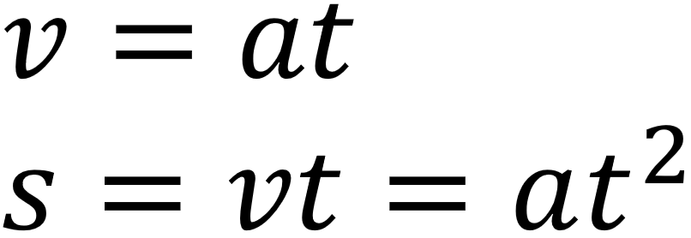
Simulation
Hello world
Start from middle school physics (a is a constant)

Slide 6
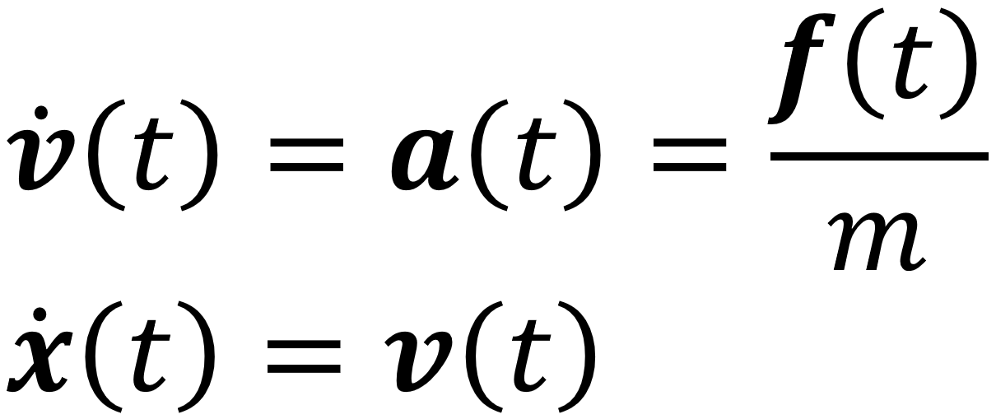
Simulation
Hello world
Start from middle school physics (a is a constant)
Calculus (a is a variable)

Slide 7
Simulation
Hello world
Start from middle school physics (a is a constant)
Calculus (a is a variable)
How to solve this ODE?

Slide 8
Simulation
Hello world
ODE

Slide 9
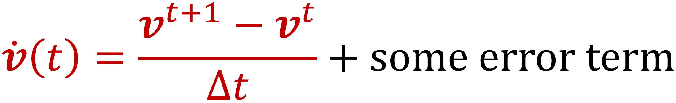
Simulation
Hello world
ODE
Let

Slide 10
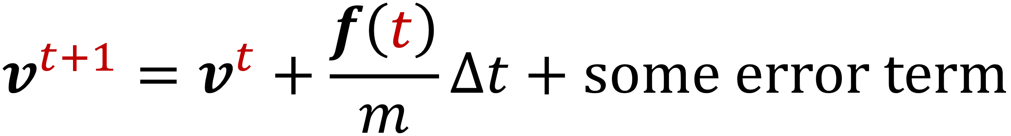
Simulation
Hello world
ODE
Let
We get

Slide 11
Simulation
Hello world
ODE
Let
We get
Forward Euler

Slide 12
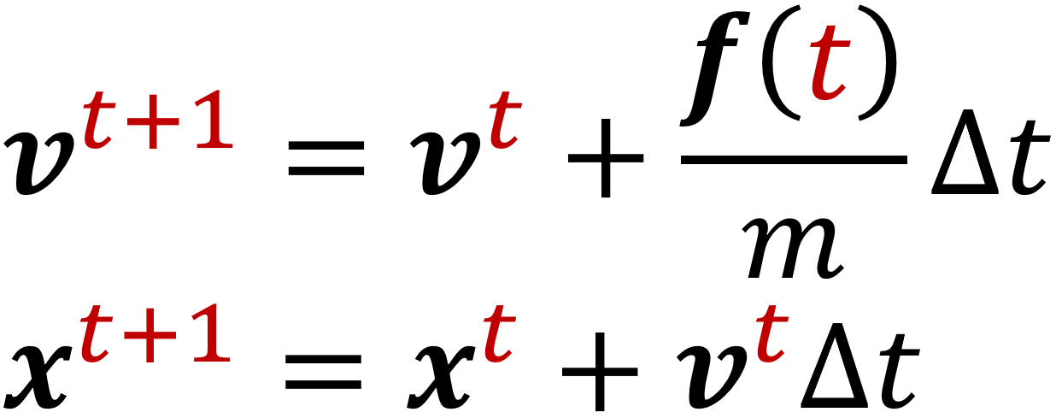
Simulation
Hello world
ODE
Similarly

Slide 13
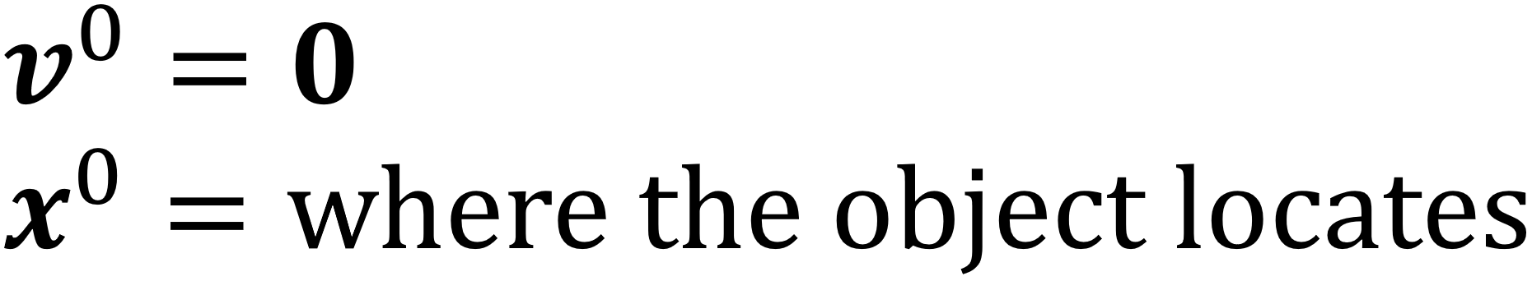
Simulation
Hello world
ODE
Similarly
Initialize

Slide 14
Simulation
Hello world
ODE
Similarly
Initialize
for (unsigned i = 0; i < 100000; ++i)
Update();

Slide 15
1. Mass Spring and Discretization

Slide 16
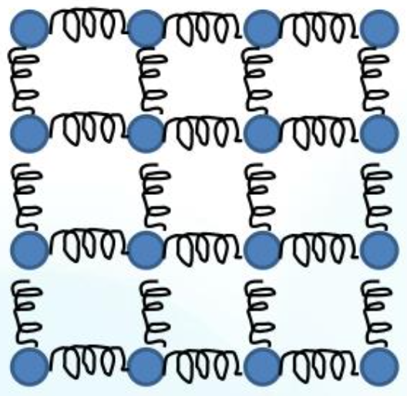
Mass Spring and Discretization
Mass
Divide cloth into masses
Cloth: 2kg
Number of masses: 40 * 30 = 1200
Weight of a mass: (2 / 1200)kg

Slide 17
Mass Spring and Discretization
Mass
Divide cloth into masses
Cloth: 2kg
Number of masses: 40 * 30 = 1200
Weight of a mass: (2 / 1200)kg
Spring
Connect masses with springs

Slide 18
Mass Spring and Discretization
Mass
Divide cloth into masses
Cloth: 2kg
Number of masses: 40 * 30 = 1200
Weight of a mass: (2 / 1200)kg
Spring
Connect masses with springs
Mass spring

Slide 19
Mass Spring and Discretization
Mass
Divide cloth into masses
Cloth: 2kg
Number of masses: 40 * 30 = 1200
Weight of a mass: (2 / 1200)kg
Spring
Connect masses with springs
Mass spring
That is Discretization

Slide 20
Mass Spring and Discretization
Mass spring
To solve

Slide 21
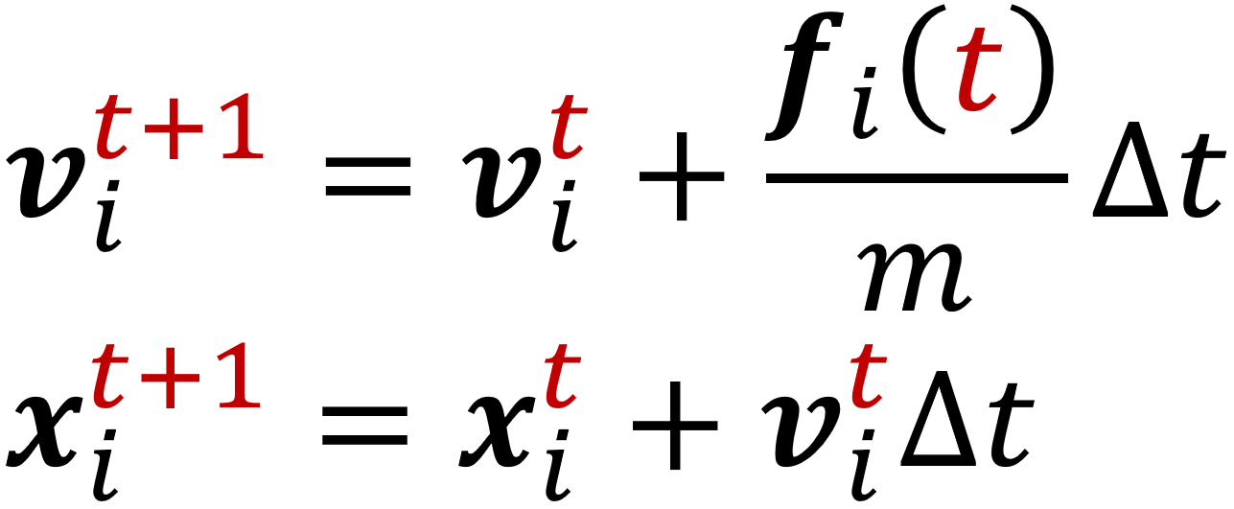
Mass Spring and Discretization
Mass spring
To solve
We try to solve it for each mass
For mass i:

Slide 22
Mass Spring and Discretization
Mass spring
To solve
We try to solve it for each mass
For mass i:
That is Discretization

Slide 23
Mass Spring and Discretization
Mass spring
To solve
We try to solve it for each mass
For mass i:
That is Discretization
Status of mass i at t+1
only depends on its status at t

Slide 24
Mass Spring and Discretization
Mass spring
To solve
We try to solve it for each mass
For mass i:
That is Discretization
Status of mass i at t+1
only depends on its status at t
Explicit!

Slide 25
Mass Spring and Discretization
Mass spring
Solve it for each mass

Slide 26
Mass Spring and Discretization
Mass spring
Solve it for each mass
Implementation
for (unsigned i = 0; i < 100000; ++i)
Update();
void Update() {
for (auto& mass : masses) {
Vec3 f = ComputeF();
mass.a = f / mass.m;
mass.v += mass.a * Δt;
mass.x += mass.v * Δt;
}
}

Slide 27
Mass Spring and Discretization
Mass spring
Solve it for each mass
Implementation
for (unsigned i = 0; i < 100000; ++i)
Update();
void Update() {
for (auto& mass : masses) {
Vec3 f = ComputeF();
mass.a = f / mass.m;
mass.v += mass.a * Δt;
mass.x += mass.v * Δt;
}
}
Q1: How to compute f?
Q2: What is Δt?

Slide 28
2. Force Computation

Slide 29
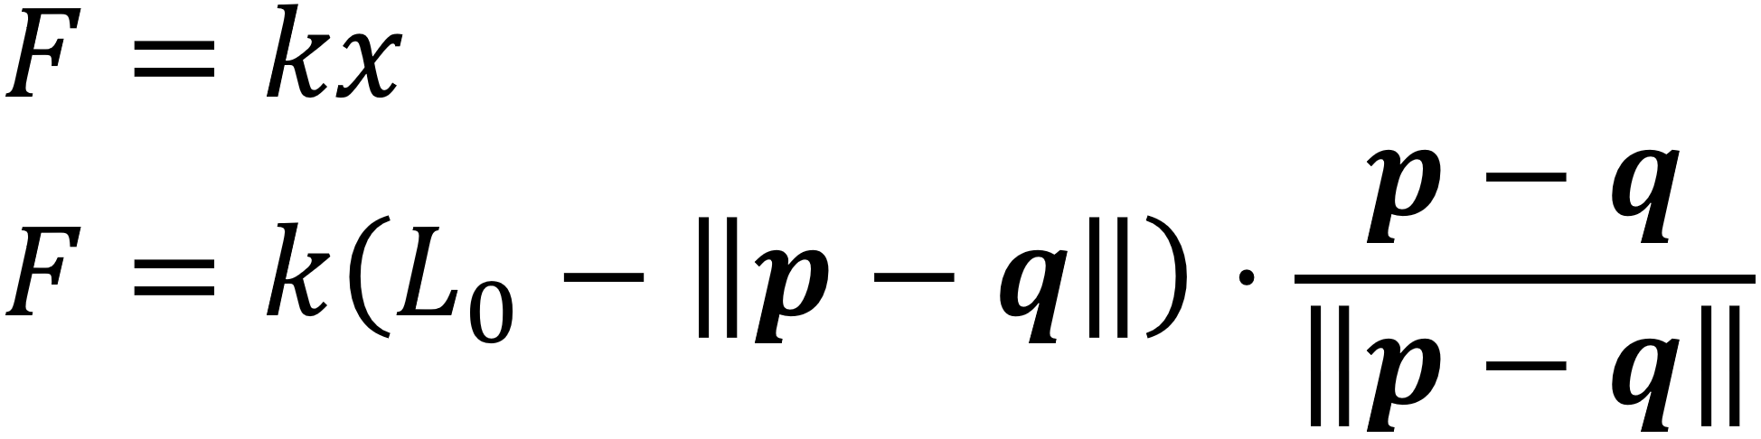
Force Computation
Hooke’s law

Slide 30
Force Computation
Hooke’s law
p and q are two masses

Slide 31
Force Computation
Hooke’s law
p and q are two masses
Rest length,
“Zero-force length”
A unit vector,
Force direction

Slide 32
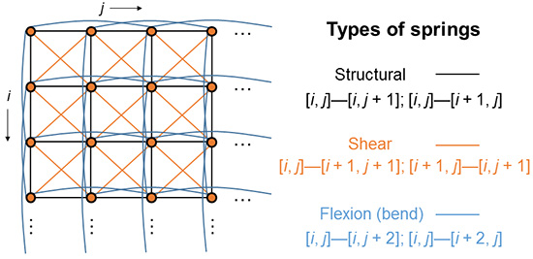
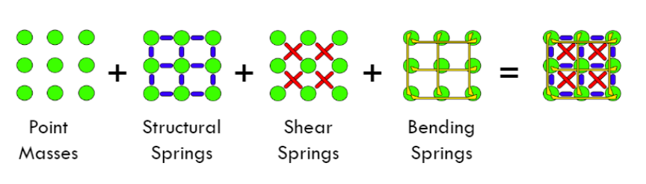
Force Computation
Hooke’s law
Mass Spring Model
[Xavier Provot 1995]

Slide 33
Force Computation
Hooke’s law
Mass Spring Model
[Xavier Provot 1995]
We are ready to compute the force f!

Slide 34
3. Fixed Delta Time

Slide 35

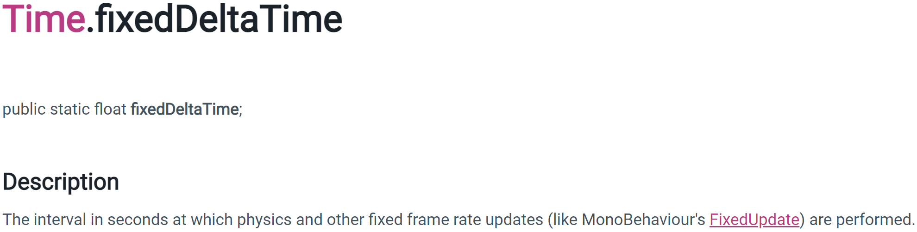
Fixed Delta Time
If you search “fixed delta time” in your browser…

Slide 36
Fixed Delta Time
Delta time v.s. fixed delta time
Suppose a = 1, “匀加速直线运动”

Slide 37
Fixed Delta Time
Delta time v.s. fixed delta time
Suppose a = 1, “匀加速直线运动”
Compare:
Case1: Your program stucks for 10s at the 2nd frame…
Case2: Your program stucks for 10min at the 2nd frame…
Are they the same?

Slide 38
Fixed Delta Time
Delta time v.s. fixed delta time
Suppose a = 1, “匀加速直线运动”
Compare:
Case1: Your program stucks for 10s at the 2nd frame…
Case2: Your program stucks for 10min at the 2nd frame…
Are they the same?
Simply let Δt = time of the 2nd frame,
Runs Update() for 1 times at the 3rd frame

Slide 39
Fixed Delta Time
Delta time v.s. fixed delta time
Suppose a = 1, “匀加速直线运动”
Compare:
Case1: Your program stucks for 10s at the 2nd frame…
Case2: Your program stucks for 10min at the 2nd frame…
Are they the same?
Never!
Simply let Δt = time of the 2nd frame,
Runs Update() for 1 times at the 3rd frame

Slide 40
Fixed Delta Time
Delta time v.s. fixed delta time
Suppose a = 1, “匀加速直线运动”
Compare:
Case1: Your program stucks for 10s at the 2nd frame…
Case2: Your program stucks for 10min at the 2nd frame…
Let Δt = 0.02s,
Runs Update() for 500 times at the 3rd frame
Let Δt = 0.02s,
Runs Update() for 5000 times at the 3rd frame

Slide 41
Fixed Delta Time
Delta time v.s. fixed delta time
Suppose a = 1, “匀加速直线运动”
Compare:
Case1: Your program stucks for 10s at the 2nd frame…
Case2: Your program stucks for 10min at the 2nd frame…
Time::fixed_update_time
= 0.02
Let Δt = 0.02s,
Runs Update() for 500 times at the 3rd frame
Let Δt = 0.02s,
Runs Update() for 5000 times at the 3rd frame

Slide 42
Fixed Delta Time
Delta time v.s. fixed delta time
Time::fixed_delta_time = 0.02
Now we are ready
for (unsigned i = 0; i < 100000; ++i)
FixedUpdate();
void FixedUpdate() {
for (auto& mass : masses) {
Vec3 f = ComputeF();
mass.a = f / mass.m;
mass.v += mass.a * 0.02f;
mass.x += mass.v * 0.02f;
}
}

Slide 43
Fixed Delta Time
Have to be done
in world coordinate!!!
Delta time v.s. fixed delta time
Time::fixed_delta_time = 0.02
Now we are ready
for (unsigned i = 0; i < 100000; ++i)
FixedUpdate();
void FixedUpdate() {
for (auto& mass : masses) {
Vec3 f = ComputeF();
mass.a = f / mass.m;
mass.v += mass.a * 0.02f;
mass.x += mass.v * 0.02f;
}
}

Slide 44
Fixed Delta Time
Have to be done
in world coordinate!!!
Delta time v.s. fixed delta time
Time::fixed_delta_time = 0.02
Now we are ready
But 0.02 maybe still large…
We may use 0.001 for HW5…
for (unsigned i = 0; i < 100000; ++i)
FixedUpdate();
void FixedUpdate() {
for (auto& mass : masses) {
Vec3 f = ComputeF();
mass.a = f / mass.m;
mass.v += mass.a * 0.02f;
mass.x += mass.v * 0.02f;
}
}

Slide 45
Fixed Delta Time
Have to be done
in world coordinate!!!
Delta time v.s. fixed delta time
Time::fixed_delta_time = 0.02
Now we are ready
But 0.02 maybe still large…
We may use 0.001 for HW5…
Only 1 week, QAQ…
So you only need to
implement this function.
for (unsigned i = 0; i < 100000; ++i)
FixedUpdate();
void FixedUpdate() {
for (auto& mass : masses) {
Vec3 f = ComputeF();
mass.a = f / mass.m;
mass.v += mass.a * 0.02f;
mass.x += mass.v * 0.02f;
}
}

Slide 46
4. Framework

Slide 47
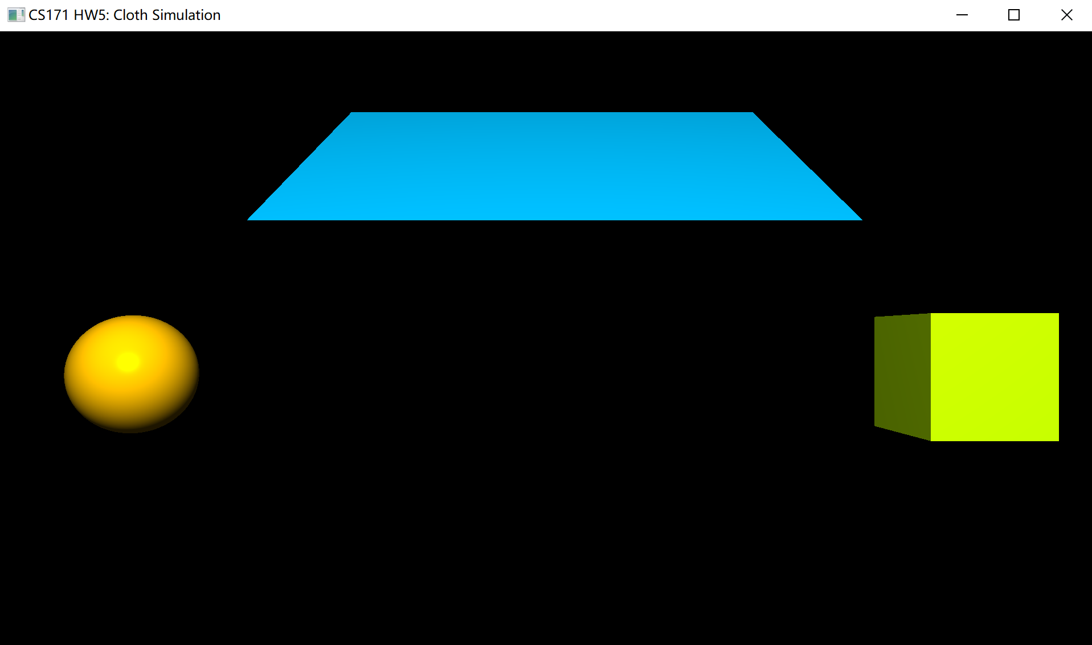
Framework
Run the code
MUST
Optional

Slide 48
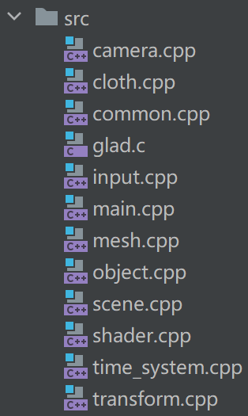
Framework
Run the code
Source
Implement a simple mass spring system here
See how cubes, spheres are generated here
You may find it helpful

Slide 49
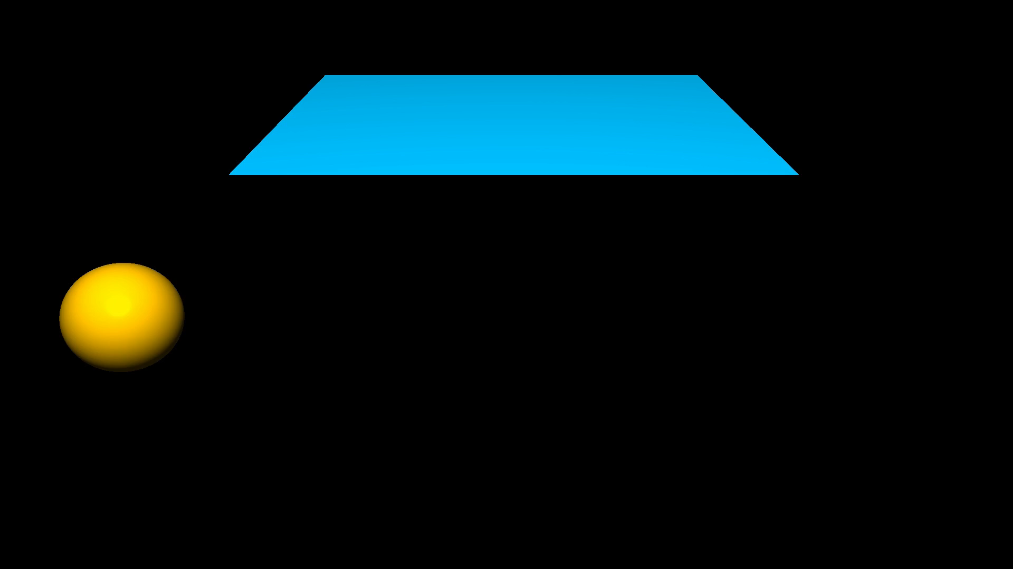
Framework
Run the code
Source
Results

Slide 50

Framework
Run the code
Source
Results

Slide 51
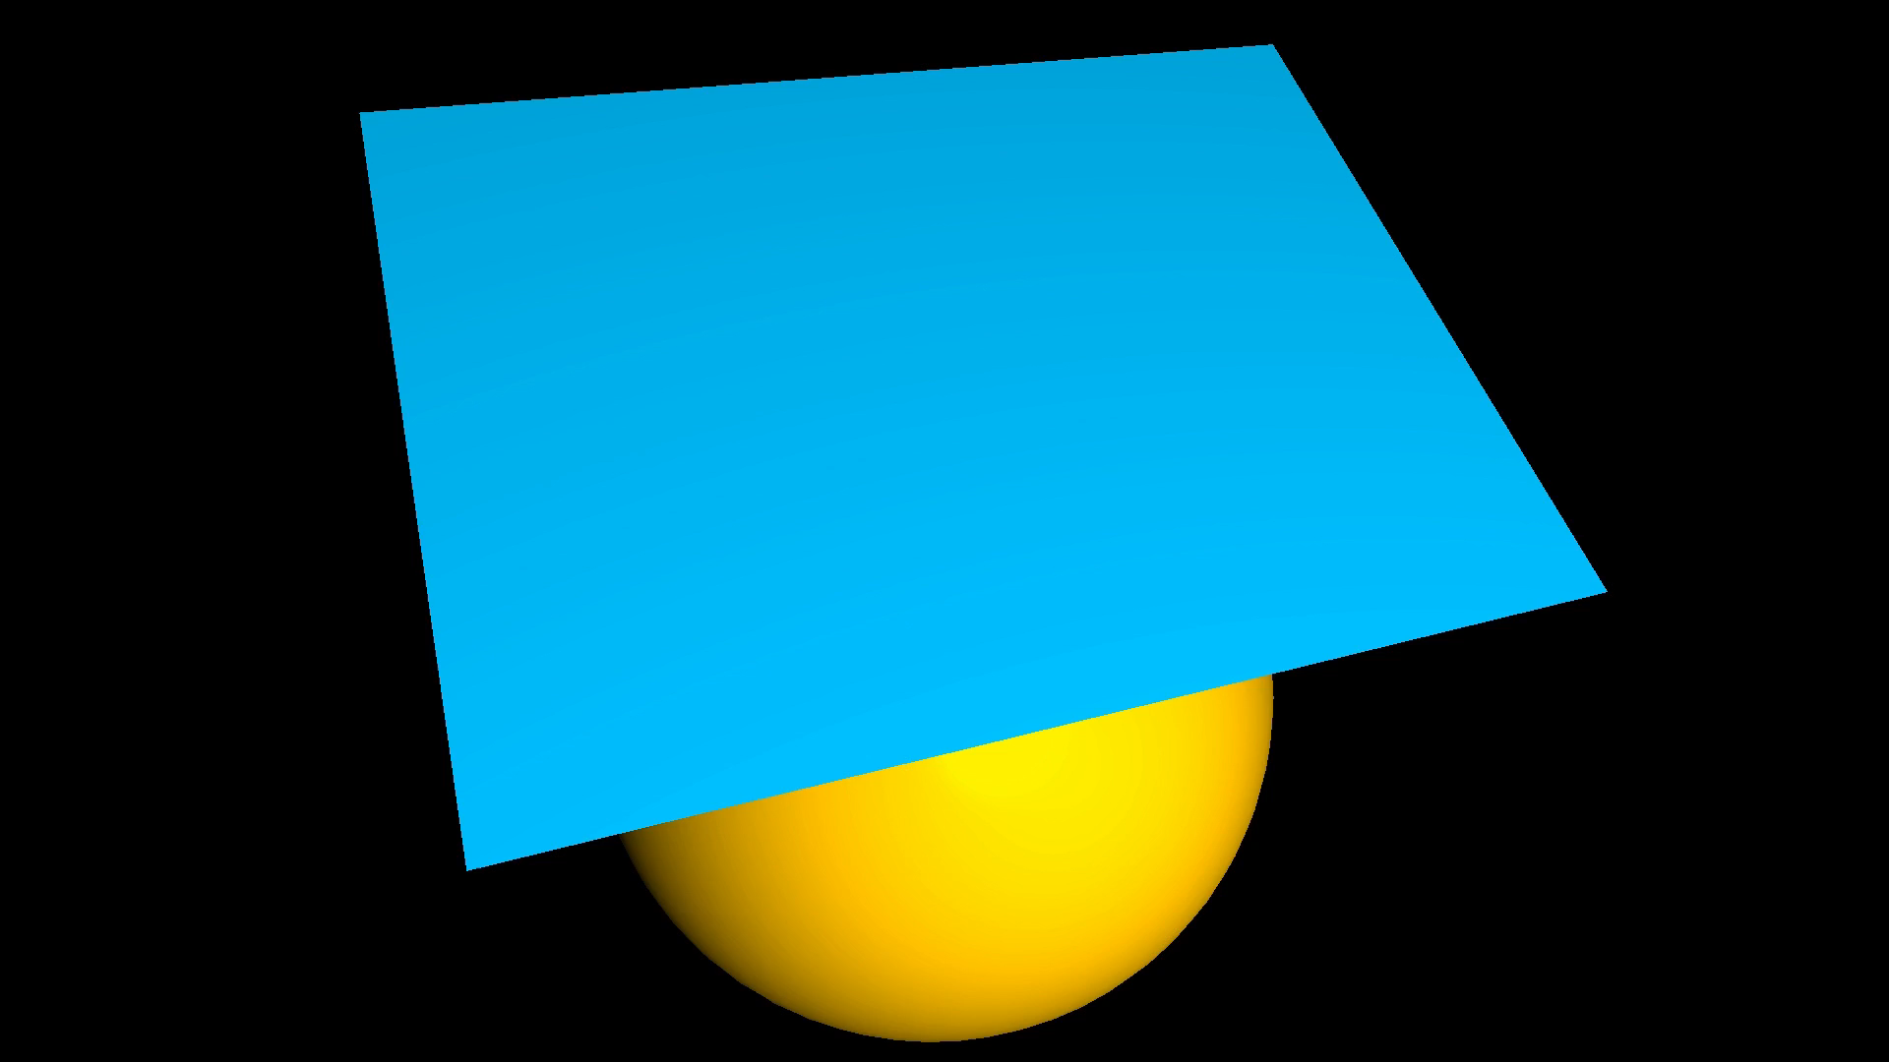
Framework
Run the code
Source
Results

Slide 52
Thank You

